Slide 1
Smart road
Thingsboard: RPC Call Demo

Slide 2
Thingsboard: RPC Call Demo
SERVER 87
SERVER 25
Light Controller
Thingsboard
MQTT
Light Controller
Light Controller
Postgres
REST
Device Nearby API
CCTV Controller
(RPC Call)
HTTP GET

Slide 3
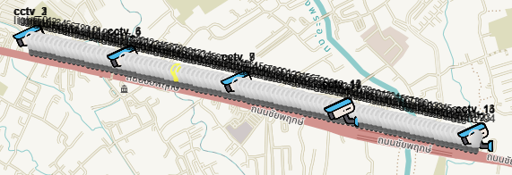
Devices on Thingsboard
LIGHT #95, CCTV#15

Slide 4
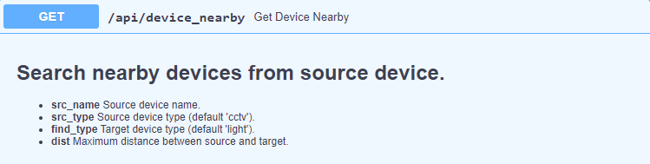
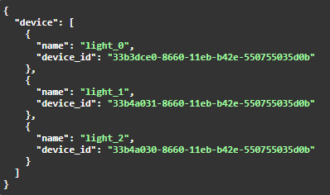
2. Device Nearby API
https://iotapi.sappasing.com/api/device_nearby

Slide 5
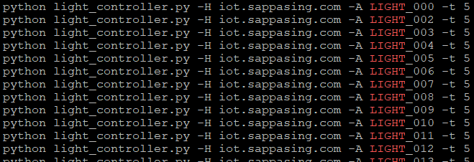
3. Light Controller
Light controller processes: LIGHT_000 - 094

Slide 6
4. RPC Call

